Slide 1
Diffusion: How Things Spread in Networks

Slide 2
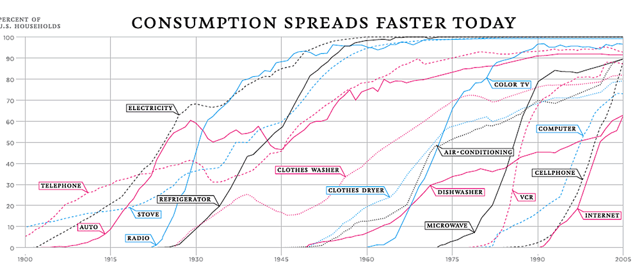
Thompson, D. (2012) The 100-Year March of Technology in 1 Graph. http://www.theatlantic.com/technology/archive/2012/04/the-100-year-march-of-technology-in-1-graph/255573/ (last accessed October 9th 2014)

Slide 3
What is diffusion?
Spread of objects, ideas, information, concepts, fashions, tastes, practices etc. in a social network
The diffusion process has five elements:
Innovation
Source
Adopter
Mechanism

Slide 4
What is diffusion?
Spread of objects, ideas, information, concepts, fashions, tastes, practices etc. in a social network
The diffusion process has five elements:
  An Innovation: The object that diffuses
Innovation
Source
Adopter
Mechanism

Slide 5
What is diffusion?
Spread of objects, ideas, information, concepts, fashions, tastes, practices etc. in a social network
The diffusion process has five elements:
  An Innovation: The object that diffuses
  Actors: Usually people but also groups that adopt (or fail to adopt) the innovation
Innovation
Source
Adopter
Mechanism

Slide 6
What is diffusion?
Spread of objects, ideas, information, concepts, fashions, tastes, practices etc. in a social network
The diffusion process has five elements:
  An Innovation: The object that diffuses
  Actors: Usually people but also groups that adopt (or fail to adopt) the innovation
  Flow : From source actor to an adopting actor
Innovation
Source
Adopter
Mechanism

Slide 7
What is diffusion?
Spread of objects, ideas, information, concepts, fashions, tastes, practices etc. in a social network
The diffusion process has five elements:
  An Innovation: The object that diffuses
  Actors: Usually people but also groups that adopt (or fail to adopt) the innovation
  Flow : From source actor to an adopting actor
  Mechanism :Process linking sources and adopters
    (e.g., imitation, physical contact, proximity, influence, comparison)
Innovation
Source
Adopter
Mechanism

Slide 8
What is diffusion?
Spread of objects, ideas, information, concepts, fashions, tastes, practices etc. in a social network
The diffusion process has five elements:
  An Innovation: The object that diffuses
  Actors: Usually people but also groups that adopt (or fail to adopt) the innovation
  Flow : From source actor to an adopting actor
  Mechanism :Process linking sources and adopters
    (e.g., imitation, physical contact, proximity, influence, comparison)
  Outcome: The end state of the adopting actor
    (e.g., opinion change, conversion, participation, infection)
Innovation
Source
Adopter
Mechanism

Slide 9

Question: Why do things diffuse?
Three Factors Accounting for Why Things Spread
  Characteristics of the object being diffused
    Familiar/unfamiliar
    High risk (consequential) v. low risk
    Cost/benefit ratio
  Characteristics of the source and adopter
    Individual versus collective actor
    High status v. Low status actor
    Similar v. dissimilar
  Environmental Context
    Proximity
    Social Foci
    Network Structure

Slide 10
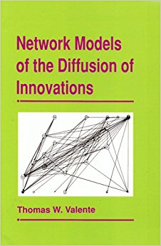
Social network models of diffusion
Diffusion via cohesion
  (Coleman et al 1966)
Diffusion via opinion leaders (two-step)
  (Katz and Lazarsfeld 1966; Rogers 1962)
Diffusion via positional equivalence
  (Burt 1987)
Diffusion via long (weak) ties
  (Granovetter 1973)
Global and Network Threshold Models
  (Granovetter and Soong 1983; Valente 1995)
Complex Contagion Models
  (Centora and Macy 2007)

Slide 11
How do things spread? The S curve
Typical S-shaped pattern of cumulative adoptions
  Initial slow uptake
  Rapid spread
  Final slow saturation
100%
S-shaped diffusion curve
Percentage of Adopters in Population
0%
Time

Slide 12
How do things spread? The S curve
Typical S-shaped pattern of cumulative adoptions
  Initial slow uptake
  Rapid spread
  Final slow saturation
100%
S-shaped diffusion curve
Percentage of Adopters in Population
0%
Time

Slide 13
How do things spread? The S curve
Typical S-shaped pattern of cumulative adoptions
  Initial slow uptake
  Rapid spread
  Final slow saturation
100%
S-shaped diffusion curve
Percentage of Adopters in Population
0%
Time

Slide 14
How do things spread? The S curve
Typical S-shaped pattern of cumulative adoptions
  Initial slow uptake
  Rapid spread
  Final slow saturation
100%
S-shaped diffusion curve
Percentage of Adopters in Population
0%
Time

Slide 15
How do things spread? The S curve
Typical S-shaped pattern of cumulative adoptions
  Initial slow uptake
  Rapid spread
  Final slow saturation
Number of adopters per unit of time peaks during the “take off” period
100%
S-shaped diffusion curve
Percentage of Adopters in Population
-
0%
Time

Slide 16
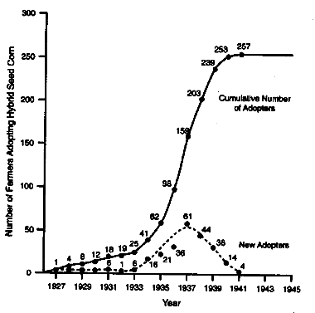
How do things spread? The S curve
Typical S-shaped pattern of cumulative adoptions
  Initial slow uptake
  Rapid spread
  Final slow saturation
Number of adopters per unit of time peaks during the “take off” period
Ryan, B. and N.C. Gross (1943) The Diffusion of Hybrid Seed Corn in Two Iowa Communities, Rural Sociology, 8: 15-24.

Slide 17
Thompson, D. (2012) The 100-Year March of Technology in 1 Graph. http://www.theatlantic.com/technology/archive/2012/04/the-100-year-march-of-technology-in-1-graph/255573/

Slide 18
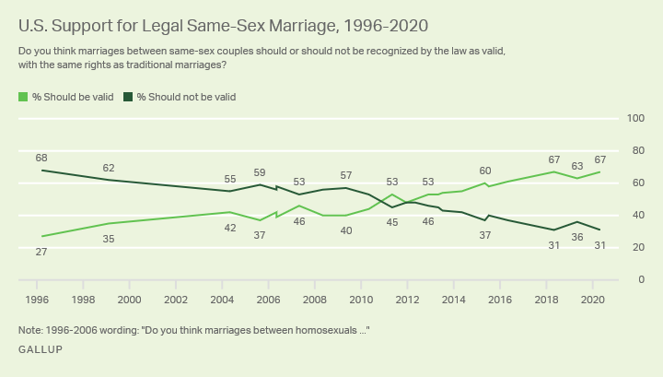
U.S. Support for Same-Sex Marriage Matches Record High
https://news.gallup.com/poll/311672/support-sex-marriage-matches-record-high.aspx

Slide 19
U.S. Support for Same-Sex Marriage Matches Record High
https://news.gallup.com/poll/311672/support-sex-marriage-matches-record-high.aspx

Slide 20
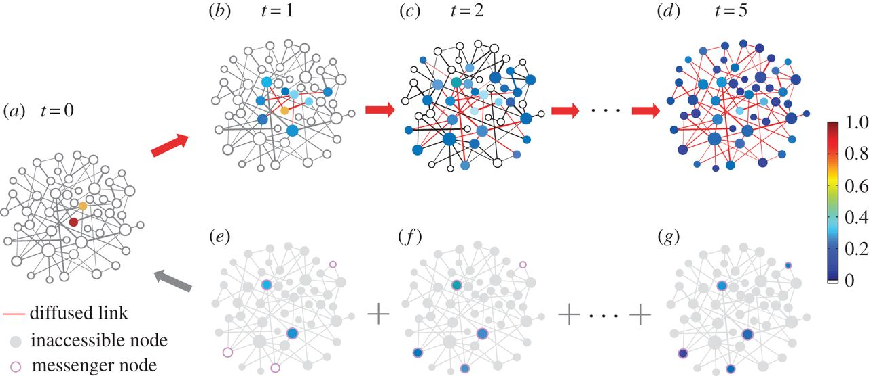
Social network models of diffusion
Four types of social network models of diffusion:
  Direct Cohesion Models
    Focus on the connectivity of adopters to their sources via network ties

Slide 21
Social network models of diffusion
Four types of social network models of diffusion:
  Direct Cohesion Models
    Focus on the connectivity of adopters to their sources via network ties
  Two-Step Models
    Focus on the social distance between adopters and influential sources as well as characteristics of influentials

Slide 22
Social network models of diffusion
Four types of social network models of diffusion:
  Direct Cohesion Models
    Focus on the connectivity of adopters to their sources via network ties
  Two-Step Models
    Focus on the social distance between adopters and influential sources as well as characteristics of influentials
  Threshold Models
    Focus on susceptibility of adopters to the behavior of multiple sources

Slide 23
Social network models of diffusion
Four types of social network models of diffusion:
  Direct Cohesion Models
    Focus on the connectivity of adopters to their sources via network ties
  Two-Step Models
    Focus on the social distance between adopters and influential sources as well as characteristics of influentials
  Threshold Models
    Focus on susceptibility of adopters to the behavior of multiple sources
  Positional Equivalence Models
    Focus on indirect influence and comparison between sources and structurally similar adopters

Slide 24
Diffusion via Cohesion
Simplest model of diffusion
Innovations “travel” via social network links
  Focuses on how innovations spread within networks
  Focuses on how patterns of connectivity help (or hinder) diffusion
  Imitation or adoption via the similarity heuristic is the main mechanism
Adopter
Innovation
Source
Adopter
Adopter
Imitation
Imitation
Adopter

Slide 25
Diffusion via Cohesion
Simplest model of diffusion
Innovations “travel” via social network links
  Focuses on how innovations spread within networks
  Focuses on how patterns of connectivity help (or hinder) diffusion
  Imitation or adoption via the similarity heuristic is the main mechanism
Similarity heuristic:
  I adopt the innovations that people like me adopt (homophily)
  Imitation mechanism
Adopter
Innovation
Source
Adopter
Adopter
Imitation
Imitation
Adopter

Slide 26
Diffusion via Cohesion
Simplest model of diffusion
Innovations “travel” via social network links
  Focuses on how innovations spread within networks
  Focuses on how patterns of connectivity help (or hinder) diffusion
  Imitation or adoption via the similarity heuristic is the main mechanism
Innovations diffuse like a “virus” (sometimes literally)
  Contagion mechanism
    Sharing a meme on social media (“going viral”)
Adopter
Innovation
Source
Adopter
Adopter
Contagion
Contagion
Adopter

Slide 27
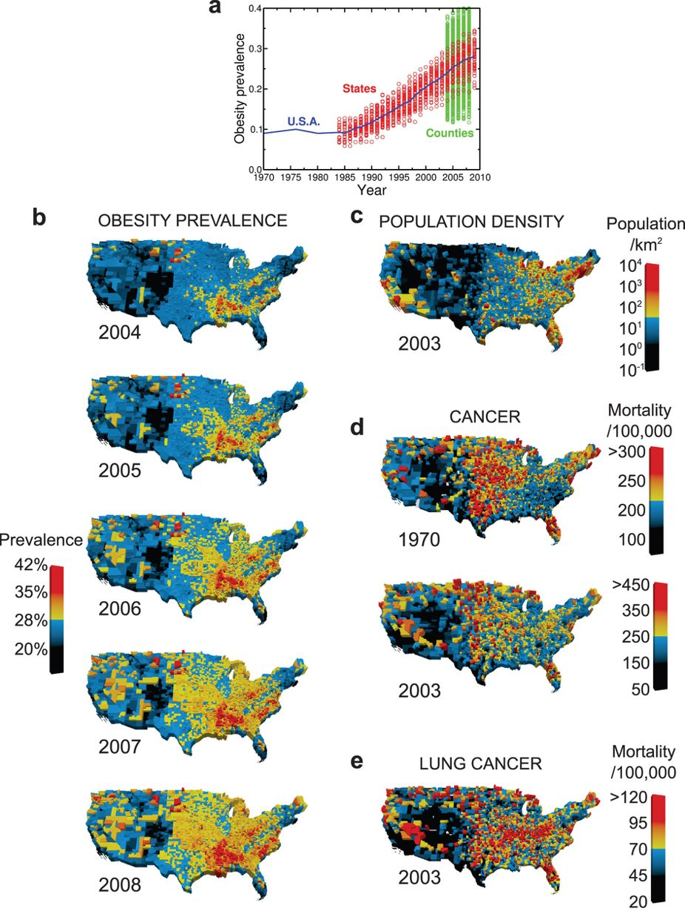
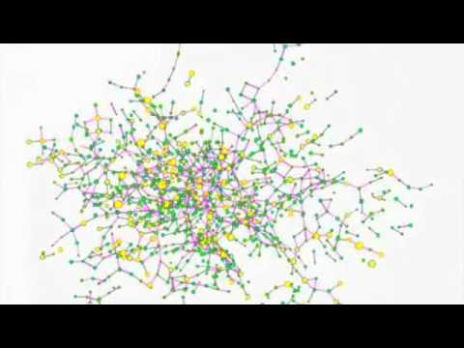
Diffusion via Cohesion

Slide 28
Diffusion via Cohesion

Slide 29
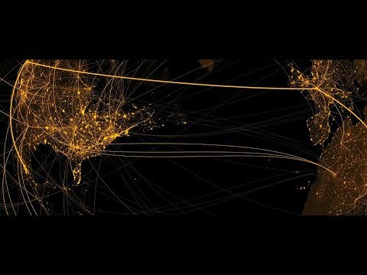
Diffusion via Cohesion (Planet of the Apes!)

Slide 30
Two step models of diffusion
Basic claim:
  Innovations diffuse via opinion leaders (“influencers”)
  Potential sources look up to opinion leaders to see what innovations they should adopt
Who are opinion leaders?
  “[P]eople who influence the opinions, attitudes, beliefs, motivations, and behaviors of others” (Valente and Pumpuang 2007: 881)
Opinion leaders are “early” or first adopters
  This is why this is called “two-step” diffusion
Innovation
Innovation
Original
Source
Opinion
Leader
Adopter
Access
Influence

Slide 31
Two step models of diffusion
Characteristics of opinion leaders:
  People who are visible (e.g., celebrities, instagram influencers)
  People who occupy powerful positions (e.g., politicians, captains of industry)
  People who are well connected
    Degree centrality (Popular people)
    Eigenvector centrality (People who can influence popular people)
    Betweenness centrality (People who can intermediate between groups)
Innovation
Innovation
Original
Source
Opinion
Leader
Adopter
Access
Influence

Slide 32
Two step models of diffusion
We can combine the two-step and cohesion models
  Innovations begin at a source and are transferred to opinion leaders
  Opinion leaders then transfer the information to adopters
  Innovation spreads via cohesion among adopters in the second step
1
2
3
Adopter
Innovation
Innovation
Original
Source
Opinion
Leader
Adopter
Adopter
Access
Influence
Imitation
Adopter

Slide 33



Coleman, Katz, and Menzel (1957)
A new drug (pseudonym "gammanym") with wide potential use is released to the market.
  Over 15 months, almost all relevant specialists in four cities adopted it. Some used it immediately, others waited.
Sociometric Mapping
Objective Adoption Data
Combining Data Sets
Researchers didn't just survey individuals in isolation. They asked doctors: Who do you turn to for advice? Who do you discuss cases with? Who are your friends? This mapped the social structure.
The "adoption date" wasn't based on memory. Researchers searched local pharmacy prescription records to find the exact month each doctor first prescribed the new drug.
The study merged objective behavioral data (prescription records) with structural data (the social network) and individual attributes (age, orientation) to build a complete picture.

Slide 34

Coleman, Katz, and Menzel (1957)
Months 3-4
Friendship Ties: Influence spreads through friendship networks, affecting those who value social ties over professional advisors.
Months 6+
Network Exhaustion: Pair-simultaneity drops to zero. Late adopters act independently of the social network (relying on ads, salesmen).
Months 1-2
Months 4-5
Professional Ties: The 'Advisor' and 'Discussion' networks show maximum effectiveness. Doctors rely on professional contacts first.
The "Isolated" Adopters: The network finally reaches less integrated doctors who adopt during this period.

Slide 35
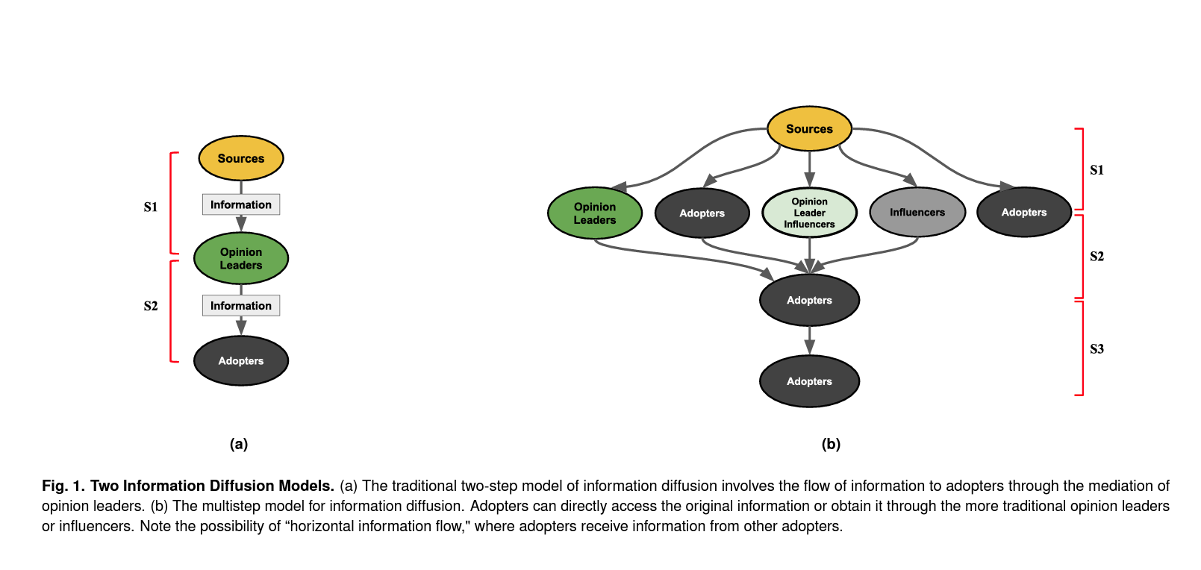

Slide 36
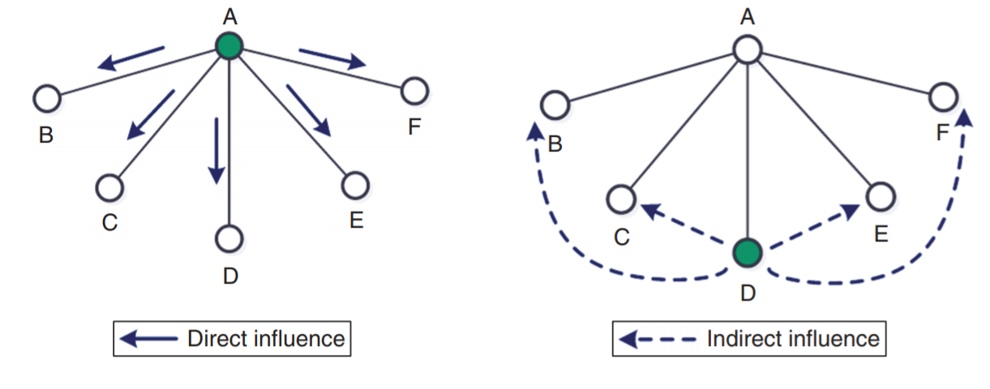
Positional equivalence model
Cohesion-based network models presume that diffusion only happens between connected actors (direct influence)
  However, the diffusion mechanism can sometimes operate among disconnected actors
This is diffusion via positional equivalence (indirect influence)
  Flashback: Positionally equivalent actors don’t have to be necessarily connected to one another!

Slide 37
Positional equivalence model
Cohesion-based network models presume that diffusion only happens between connected actors (direct influence)
  However, the diffusion mechanism can sometimes operate among disconnected actors
This is diffusion via positional equivalence (indirect influence)
  Mechanism: Comparison to similarly positioned others
Innovation
Source
Adopter
Comparison
Alter
Alter
Alter
Alter
Alter
Alter

Slide 38
Global threshold model
If your friend jumped off a bridge would you?
  Better question:
    How many other people would have to jump before you did?
  What is your q?
100%
S-shaped diffusion curve
Percentage of Adopters in Population
0%
Time

Slide 39
Global threshold model
If your friend jumped off a bridge would you?
  Better question:
    How many other people would have to jump before you did?
  What is your q?
Each actor (i) has a “threshold” for adoption q(i)
  q_{i} is between zero and one
    0 > q(i) < 1
  (i) adopts when the proportion of people who have adopted (p) is equal to q(i)
100%
S-shaped diffusion curve
Percentage of Adopters in Population
0%
Time

Slide 40
Global threshold model
People have different q values
  Some high
  Some Low
  Most in the Middle (a bell curve)
This can explain the S-shaped pattern
  Slow uptake when adoption is concentrated among a few low q people
  Faster as the majority of middle q people join in
  Slow again as the last few high q people finally adopt
Probability of Adoption
Proportion of people with this q value
-
Low q
Middle q
High q

Slide 41
Global threshold model
People have different q values
  Some high
  Some Low
  Most in the Middle (a bell curve)
This can explain the S-shaped pattern
  Slow uptake when adoption is concentrated among a few low q people
  Faster as the majority of middle q people join in
  Slow again as the last few high q people finally adopt
High-risk early adopters
Risk-averse late adopters
Probability of Adoption
Proportion of people with this q value
-
Low q
Middle q
High q

Slide 42
Global threshold model
Too many risk-averse late adopters
People have different q values
  Some high
  Some Low
  Most in the Middle (a bell curve)
The shape of the threshold distribution can determine whether you get full diffusion or not:
  If q distribution is skewed toward risk averse late adopters the diffusion is less likely
Two few high-risk early adopters
Probability of Adoption
Proportion of people with this q value
-
Low q
Middle q
High q

Slide 43
Global threshold model
Plenty of high risk early adopters
Not too many averse late adopters
People have different q values
  Some high
  Some Low
  Most in the Middle (a bell curve)
The shape of the threshold distribution can determine whether you get full diffusion or not:
  If q distribution is skewed toward high risk early adopters diffusion is more likely
Probability of Adoption
Proportion of people with this q value
-
Low q
Middle q
High q

Slide 44
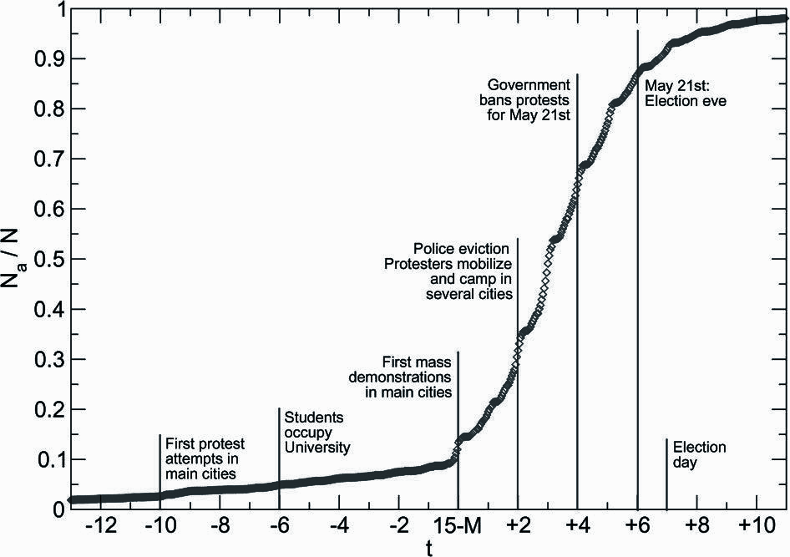
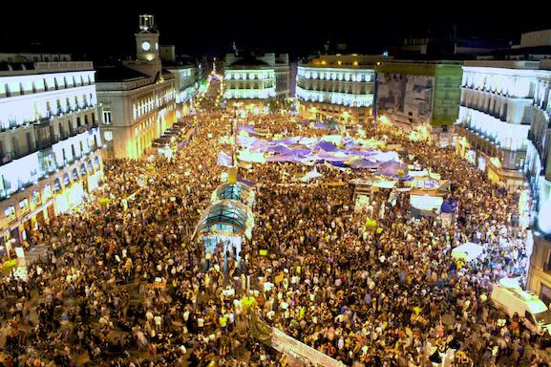
How do things spread? The S curve
Typical S-shaped pattern of cumulative adoptions
  Initial slow uptake
  Rapid spread
  Final slow saturation
González-Bailón, S., Borge-Holthoefer, J., Rivero, A., & Moreno, Y. (2011). The dynamics of protest recruitment through an online network. Scientific Reports, 1, 197.

Slide 45
How do things spread? The S curve
Typical S-shaped pattern of cumulative adoptions
  Initial slow uptake
  Rapid spread
  Final slow saturation
<- Long uptake period! ->
González-Bailón, S., Borge-Holthoefer, J., Rivero, A., & Moreno, Y. (2011). The dynamics of protest recruitment through an online network. Scientific Reports, 1, 197.

Slide 46
How do things spread? The S curve
Big mobilization helps to recruit high threshold people leading to rapid spread
Typical S-shaped pattern of cumulative adoptions
  Initial slow uptake
  Rapid spread
  Final slow saturation
González-Bailón, S., Borge-Holthoefer, J., Rivero, A., & Moreno, Y. (2011). The dynamics of protest recruitment through an online network. Scientific Reports, 1, 197.

Slide 47
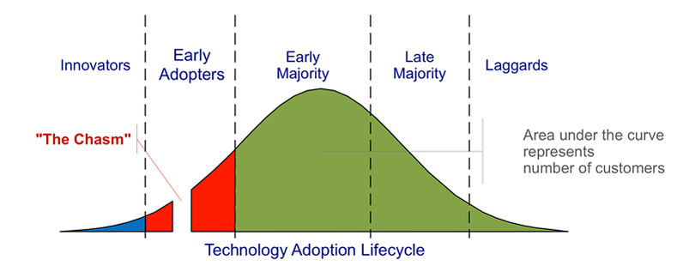
The Rogers Classification of Adopters
Area under the curve represents number of adopters
Kastelle, T (2012) Two Problems Caused by the Innovation Diffusion Curve
http://timkastelle.org/blog/2012/02/two-problems-caused-by-the-innovation-diffusion-curve/ (last accessed October 9th 2014)

Slide 48

The Rogers Classification of Adopters
Proportion of adopters
Rogers, E.M.(1962) The Diffusion of Innovations, Free Press, New York.

Slide 49
The Rogers Classification of Adopters
Proportion of adopters
Rogers, E.M.(1962) The Diffusion of Innovations, Free Press, New York.

Slide 50
The Rogers Classification of Adopters
Tipping point
Proportion of adopters
Rogers, E.M.(1962) The Diffusion of Innovations, Free Press, New York.

Slide 51
The Rogers Classification of Adopters
Failed Innovations die before reaching the tipping point
Proportion of adopters
Rogers, E.M.(1962) The Diffusion of Innovations, Free Press, New York.

Slide 52
The Rogers Classification of Adopters
Innovators and Early adopters
  Individuals whose time-of-adoption is greater than one standard deviation earlier than the average time-of-adoption
Early and late majorities
  Individuals whose time-of-adoption is bounded by one standard deviation earlier and later than the average
Laggards
  Individuals who adopted later than one standard deviation from the average
Proportion of adopters

Slide 53
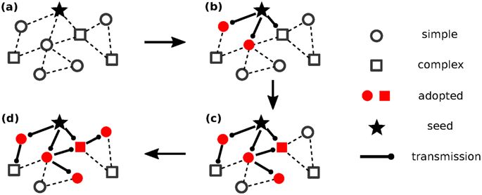
Complex versus simplex contagion
Innovations that entail risk, ostracism, potential loss of resources, may elicit higher thresholds from all actors in the network
  Persons require exposure to multiple sources to adopt
This is the difference between simplex and complex contagion
  Certain innovations only diffuse via complex contagion

Slide 54
Complex versus simplex contagion
Candidates for simplex contagion:
  Information, gossip, disease
Candidates for complex contagion:
  High risk social movement participation, religious conversion, migration, etc.

Slide 55
Complex versus simplex contagion
Weakness of long ties argument (Centola and Macy 2007):
  Long (weak) ties help to spread things in networks faster
    But only for things that spread via simplex contagion
  They are worse at spreading things that require complex contagion
    You are usually connected to one network bridge and access the tie infrequently

Slide 56
Complex versus simplex contagion
Information, gossip, disease:
  Can spread faster in a network via weak ties (bridges)
    Strength of Weak Ties (Granovetter 1973)
High-risk social movement participation, religious conversion, migration:
  Can spread faster via cliques and strong ties

Slide 57
Network Threshold Models
Global threshold models are appropriate for adoptions of behaviors that are public and observable
  Not always the case
  Assumption that people know what everyone is doing is not always realistic
    People must know the actual proportion of population who has adopted
The network threshold model relaxes the assumption that persons have global information on all adoptions
  They only know what their direct contacts are doing
  Individuals adopt when some proportion of their contacts adopt
    More appropriate for the adoption of practices, behaviors and ideas that entails some sort of risk or uncertainty (complex contagion)

Slide 58
Valente’s Network Threshold Model
Each person (i) has some exposure e(i)
e(i) = proportion of i’s friends who adopted
When proportion of neighbors who adopt equals q(i), ego adopts
Person 1: q = 0.25
Person 2: q = 0.75
Time 1
Time 2
Time 3
Time 4
Time 5

Slide 59
Network Threshold Models
Just like before, everybody has a threshold q(i)
  When the proportion of neighbors who have adopted equals q(i), the person adopts
We can then redefine adopter categories (e.g. innovators) as either
  System Relative
    Whole network
  Network Relative
    Ego-network
For instance you can be an innovator in the grand scheme of things
  But be a relative laggard compared to your friends
  If all of your friends are innovators
You can be a laggard in the grand scheme of things
  But be an innovator among your friends
  Because you are surrounded by even bigger laggards!

Slide 60
Valente’s Network Threshold Model
Revisiting the Roger’s classification using Valente’s model:
Who's an “opinion leader”?
  Early adopters who convince those with high network thresholds (but similar system threshold) to adopt
Whole Network Threshold
Low High
Personal Network Threshold
Low
High
True innovators (influentials) | Isolates
Connected Bandwagon | Resistant rearguard

Slide 61
Valente’s Network Threshold Model
The network threshold model makes sense of a lot of classic findings
  For instance, early adopters adopt from media or weak ties, late adopters adopt from their friends/strong ties
    This seems to reflect a Local/Cosmopolitan split
Whole Network Threshold
Low High
Personal Network Threshold
Low
High
True innovators (influentials) | Isolates
Connected Bandwagon | Resistant rearguard

Slide 62
Valente’s Network Threshold Model
The network threshold model makes sense of a lot of classic findings
  For instance, early adopters adopt from media or weak ties, late adopters adopt from their friends/strong ties
    Cosmopolitan innovators tend to be early adopters relative to the system and have very low threshold relative to their network
Whole Network Threshold
Low High
Personal Network Threshold
Low
High
True innovators (influentials) | Isolates
Connected Bandwagon | Resistant rearguard

